Slide 1
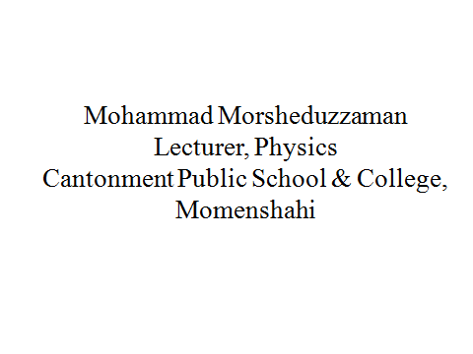
Welcome

Slide 2
Thermodynamics
Feedback
What is the isobaric process?
What happened in case of adiabatic expansion ?

Slide 3
Thermodynamics
Today’s class Lesson
Heat engine and Carnot engine

Slide 4
Thermodynamics
Heat Engine
The engine which transfer heat energy into mechanical energy is called heat engine

Slide 5
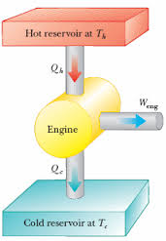
Thermodynamics
Heat Engine

Slide 6
Thermodynamics
Heat Engine

Slide 7
Thermodynamics
Heat Engine
Again in case of heat engine absorbing or releasing heat Q is directly proportional to temperature T i.e.,
Q₁/T₁= Q₂/T₂
Or, Q₂/Q₁ = T₂ /T₁
But n = 1- Q₂/Q₁
Therefore, n = 1- T₂ /T₁
n= (T₁ - T₂ )/ T₁
n= (T₁ - T₂ )/ T₁ ×100%

Slide 8
Thermodynamics
Carnot engine
The process for giving clear explanation about transformation of heat energy into mechanical energy Frence Engineer Sadi Carnot imagined an ideal heat engine which is called Carnot engine.

Slide 9
Thermodynamics
Carnot engine
There are four parts in a Carnot engine. These are:
Reservoir (source) of heat
Working substance with cylinder and piston
Cold reservoir or Sink or Condenser
Non conductor substances

Slide 10
Thermodynamics
Carnot engine

Slide 11
Thermodynamics
Home Work
1. What is the efficiency of a heat engine?
2. How many parts are there in a Carnot engine? What are they?

Slide 12
Thermodynamics
Evaluation
1. What is the efficiency of a heat engine?
2. How many parts are there in a Carnot engine? What are they?

Slide 13
Thermodynamics
?

Slide 14
Thermodynamics
Home work
1. The efficiency of a heat engine is 80%. If the temperature of the sink is 127⁰c, what is temperature of the source?
2. Write down 10 MCQ on today’s topics

Slide 15
Thanks

